Slide 1



DIGITIZATION OF PHYSICAL RECORDS
Preet Jain & Aakanksha Pote

Slide 2


AMBITION
To discuss the importamce of digitizing physical records for accessibility and convience.
Also to highlight the challenges faced due to
regional language and the need for translation.

Slide 3

INNOVATION OF SOLUTION
Explain the use of OCR (Optical Character Recognition) technology to extract text from images.
Describe the use of translation services to convert regional language text to English.

Slide 4
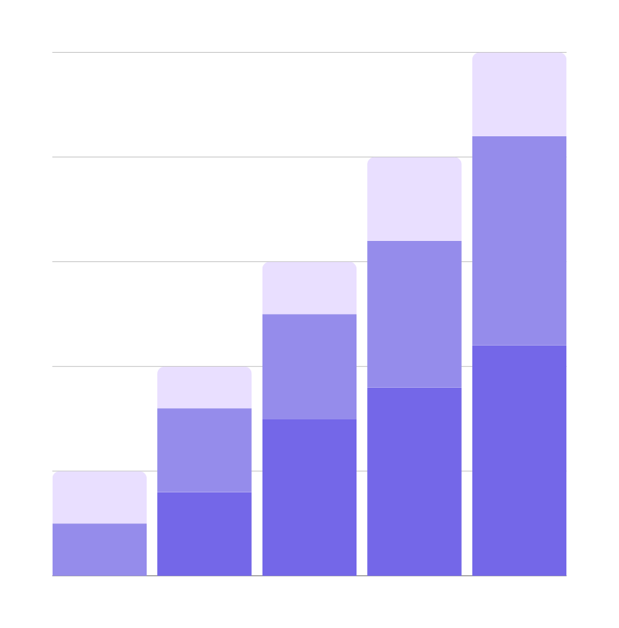
SOCIETAL IMPACT
Discuss how digitization improves accessibility to information for non-native speakers.
Highlight the benefits for researchers, historians, and government agencies in preserving and accessing historical records.

Slide 5

FUTURE SCOPE
Expanding the project to include multiple regional languages will enhance global accessibility and cultural exchange. By digitizing documents in various languages, the project can contribute to preserving diverse cultural heritage and facilitating cross-cultural understanding. This expansion can also lead to the development of multilingual tools for broader document digitization efforts.

Slide 6
CONCLUSION
Digitizing pre-2014 physical records, especially in regional languages, is crucial for preserving cultural heritage and enhancing accessibility. Converting these documents, such as Hindi, into English makes them readable to a wider audience, emphasizing the importance of digitization in preserving and sharing cultural knowledge.

